Slide 1

Evolution of Maternal Health in Bangladesh
and philosophy of professor S M Mokhlesur Rahman
Dr. Md Emdadul Haqus
Associate professor (Gynae & Obs)
Addin Sakina Women’s Medical Collage, Jashore

Slide 2

The philosophy of Prof. S M Mokhlesur Rahman
1st Aug. 1920 – 31st Dec. 1995
“I am the representative of the mothers of Bangladesh. I want safe motherhood like safe fatherhood.”
“During the marriage of your daughter, you should mention in Kabinnama that your daughter should delivered her baby in hospital”

Slide 3
Bio-data of Prof. Mokhlesur Rahman
Professor Mokhlesur Rahman was born in 1st August in 1920 in Bhola. His father,s name Md.Momtaz Uddin Ahammed. His ancestral home was Chor Mollikpur under Lohagara Upazilla in Narail district.
He passed Matriculate in 1939 from Barisal Zilla School and ISc. from Barisal BM College in 1941. He admitted in Calcutta Medical Collage in 1942. and passed M.B in 1946. He was the 1st RS (Gynae) of Dhaka Medical Collage Hospital in 1946.
He got DGO from London in 1965. He worked in Mymensingh and Sylhet Medical Collage. In 1978, he joined as a professor of Obst. & Gynae at DMC.
He retired in 1980. He died on 31st December in 1995 at BIRDEM due to liver cancer.
He was involved in MRTSP program, 1st private medical collage initiative at Bajitpur under Kishoregonj district.

Slide 4
History and Evolution of Maternal Health service in Bangladesh
1946 – Establishment of DMC.
1953 – Starting of FP program by Non-govt. system.
1960 – Rural Health Complex Development by local Govt.
1963 – Starting of Family planning service in Govt. program.
1973 – Integration of district health council with Govt. program.
1976 – National family planning policy.
1979 – MR policy adopted and started EPI and training of TBA.
1980 – MCH breast family planning program.
1985 – Intensification of EPI.
1994 – EOC program started.
2001 – Maternal Health strategy 2001.
2003 – Community based SBA program.
2006 – Maternal Health DSF program.
2000-2015 – MDG program.
2015-2030 – SDG program.

Slide 5
Maternal Health Situation in Bangladesh and Greater Jashore ( in 2019)
Indicator | Bangladesh | Greater Jashore
Total population | 1670 lak. | 247 lak.
Total delivery | 29.24 lak | 1.15 lak
Maternal death(172/lak LB) | 4,971 | 200
Maternal morbidity | 1,49,124 | 6,000
Perinatal death(20/1000 DL) | 58,480 | 2,300
Neonatal death(19.1/1000LB) | 55,836 | 2,196
Disability ( 10%) | 2.92 lak | 11,500
Low birth weight (14.5%) | 4.39 lak | 17,250
Hospital delivery(49%) | 14.33 lak | 47,826(55%)

Slide 6
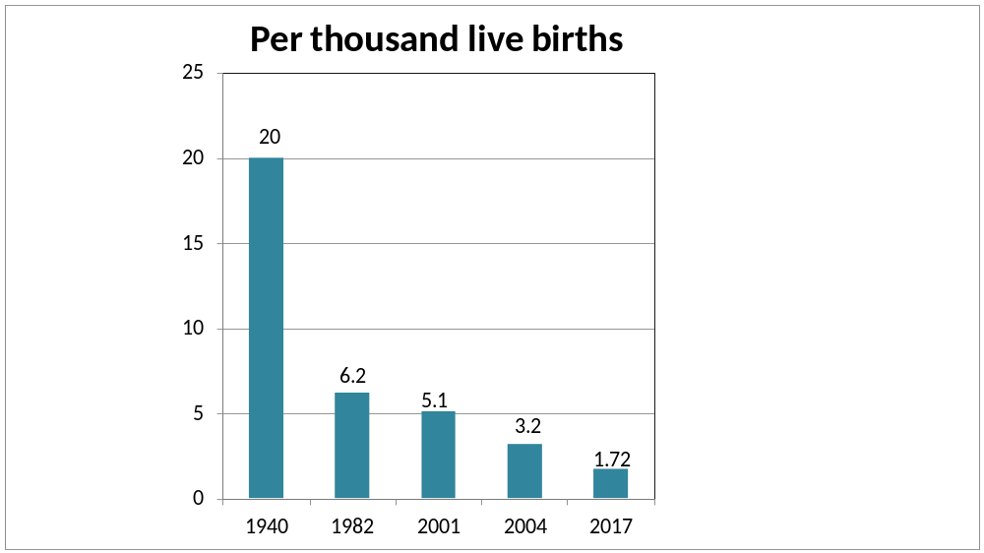
MMR in Bangladesh
From 1940-2017

Slide 7
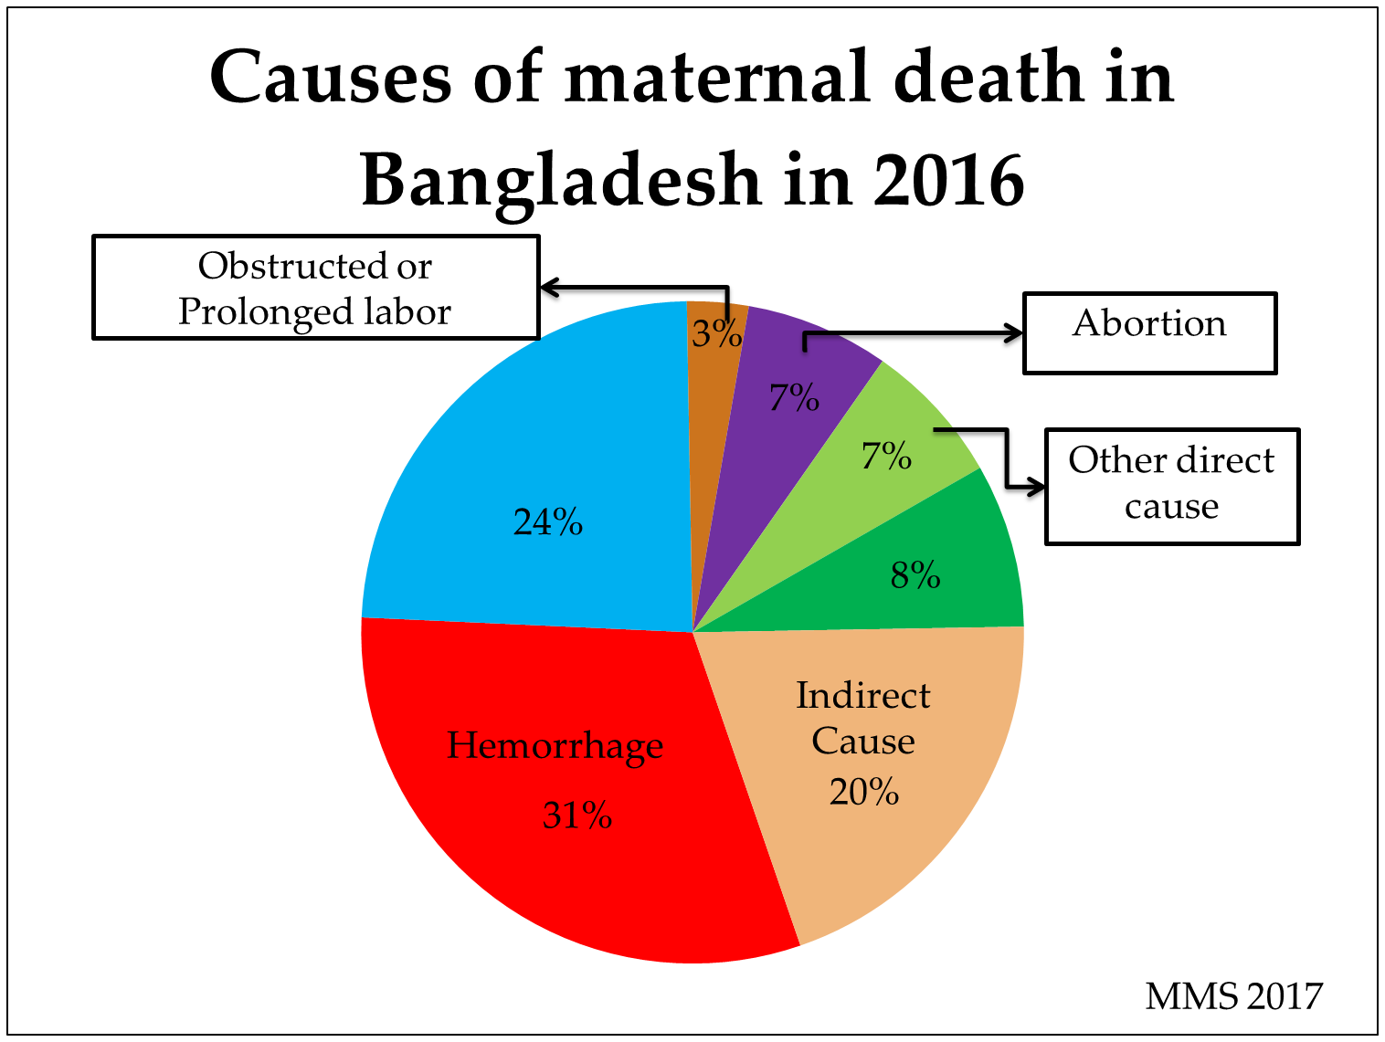
Eclampsia
Undetermined

Slide 8
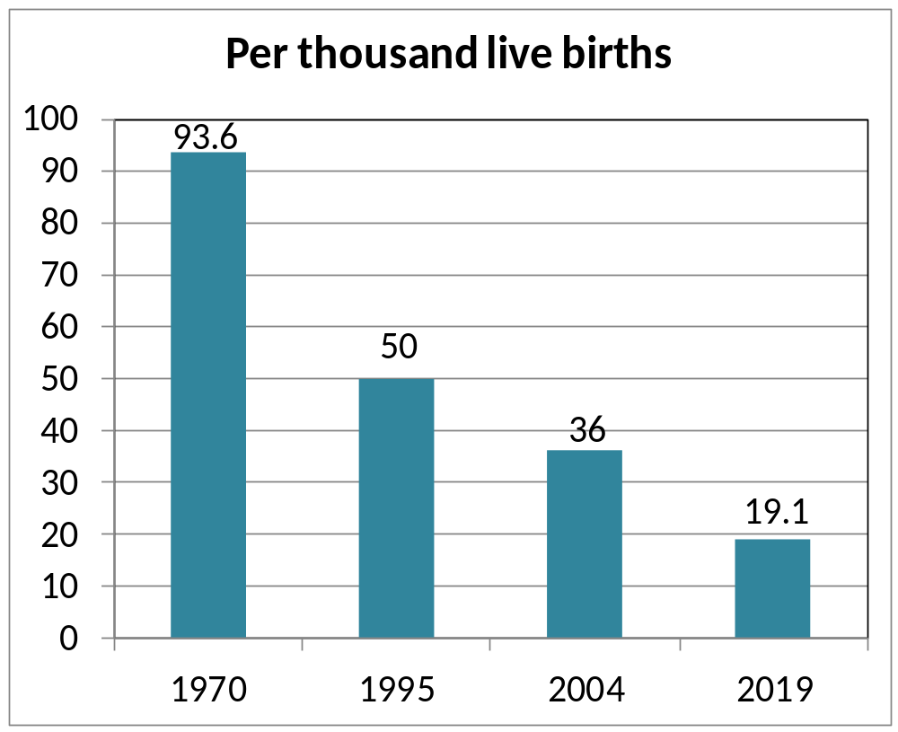
Neonatal Mortality rate in Bangladesh
From 1970-2019

Slide 9
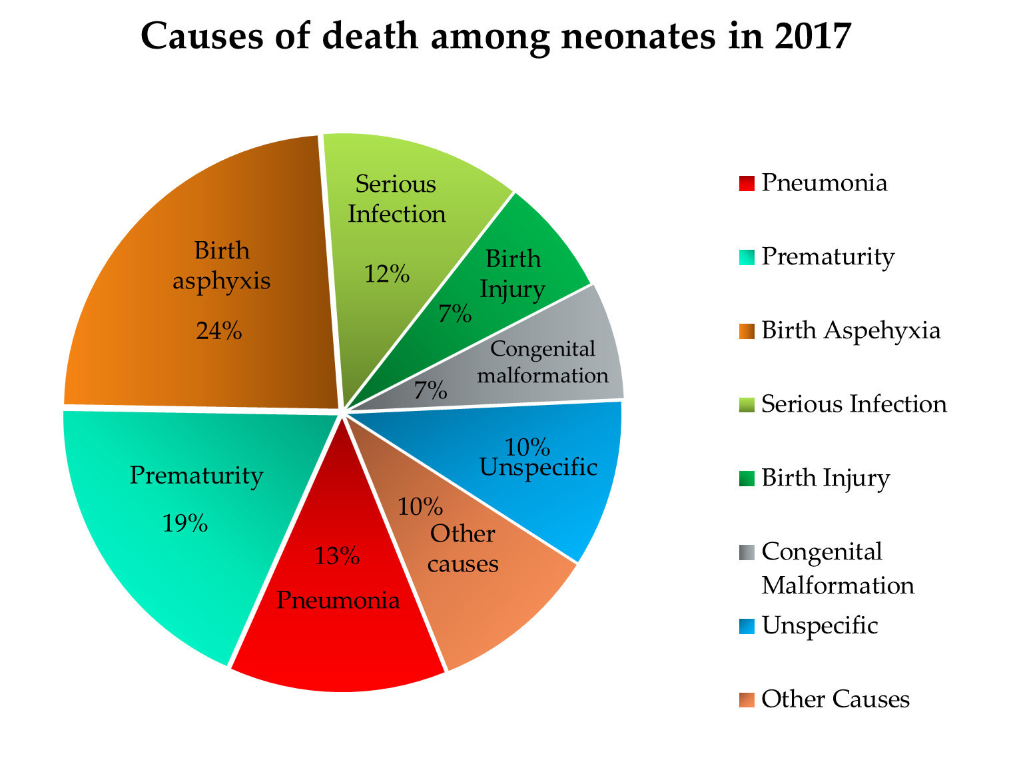

Slide 10
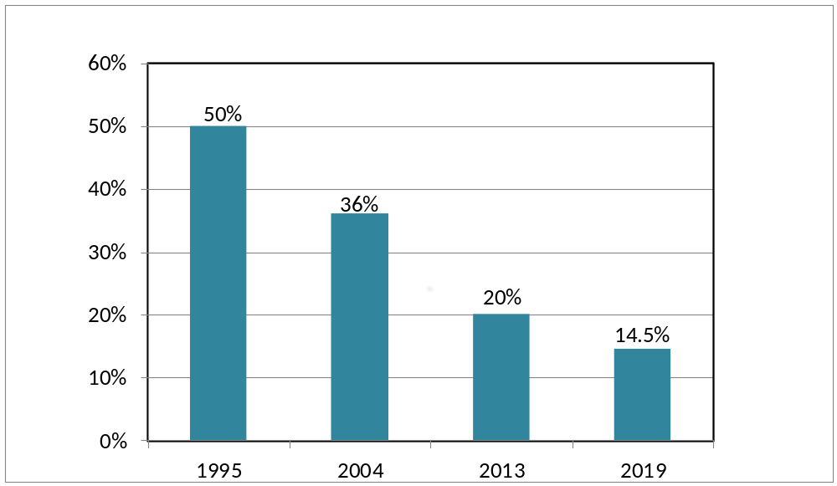
Low birth weight situation in Bangladesh
From 1995-2019

Slide 11
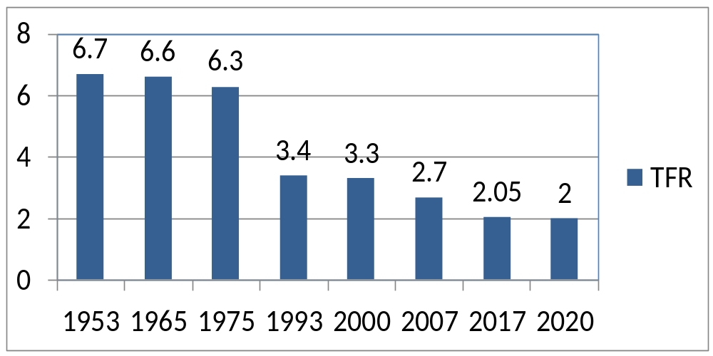
TFR in Bangladesh from 1950-2020
.
Family planning reduces:
    66% unwanted pregnancy.
    30% MMR.
    20% NMR.
    40% High risk pregnancy.

Slide 12
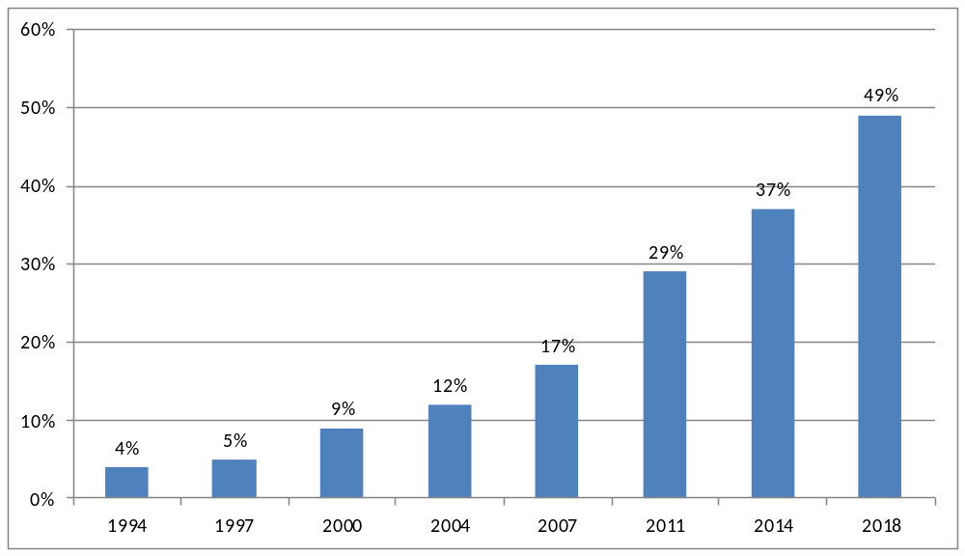
Trends in hospital delivery rate in Bangladesh
From 1994-2018
BDHS-2018

Slide 13
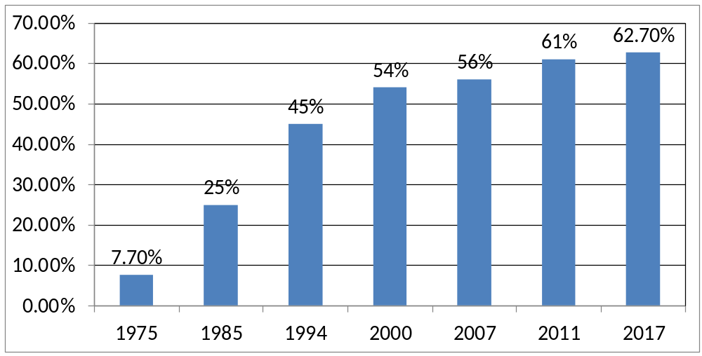
Contraceptive prevalence rate in Bangladesh
From 1975-2020
BDHS-2018

Slide 14
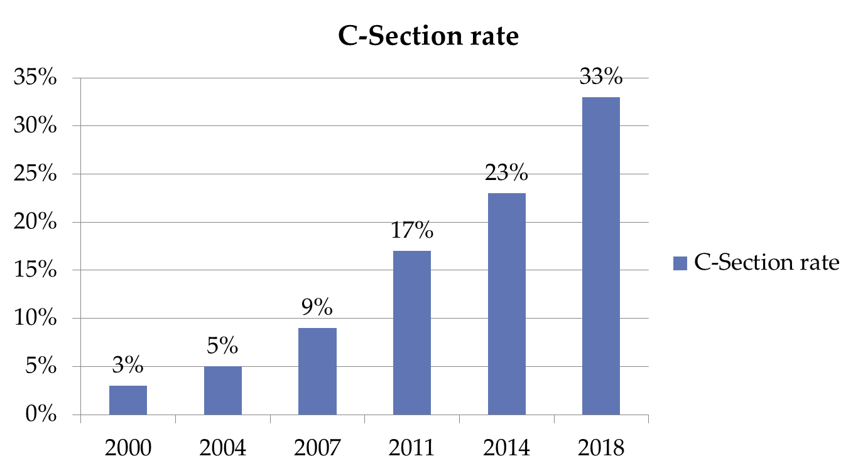
Per cent of delivery by C-Section in hospital
From 2000-2018
BDHS-2018

Slide 15
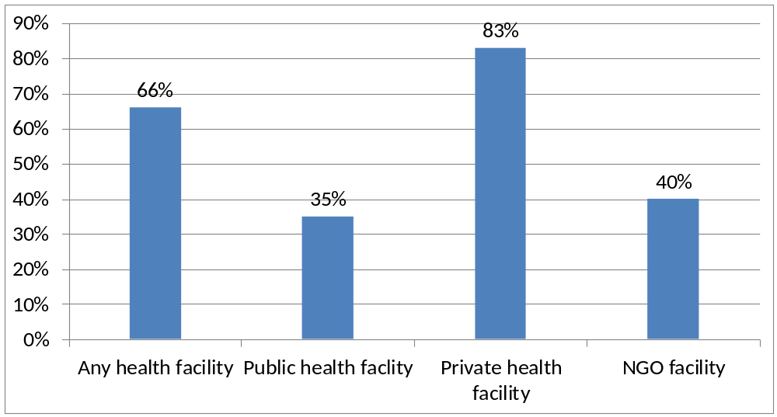
Delivery by C-Section according to type of health facility in 2018
BDHS-2018

Slide 16
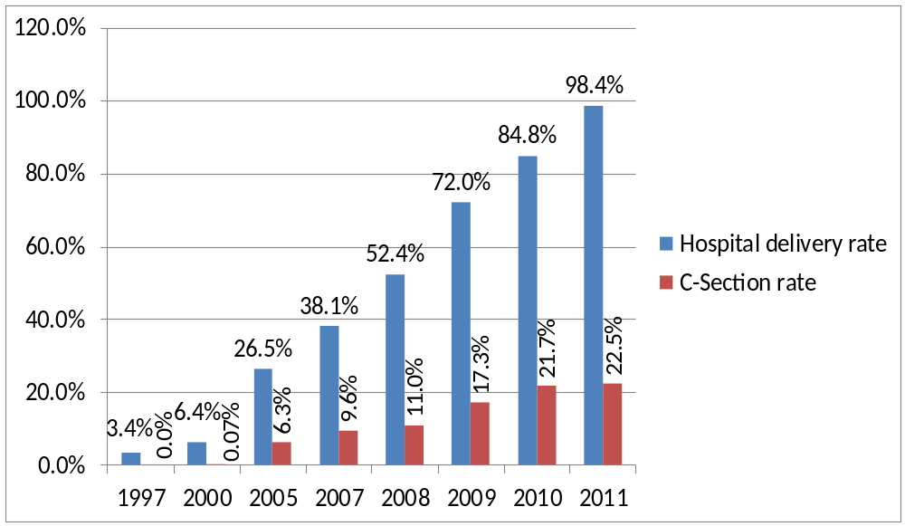
Progress of hospital delivery in Chowgacha UHC From 1997-2011

Slide 17
Way Forward
Every mother should deliver their baby in Gov. hospital.
Hospital bed should be increased to 1 bed per hundred delivery like Chowgacha UHC.
Request to all to give your valuable informations about our legend Prof.S M Mokhlesur Rahman for documentation.

Slide 18

Thank you
Chitra River

